Slide 1
Sharing Session
Mask-RCNN using Detectron2
We will learn together about some of computer vision problems, and will try Mask-RCNN architecture to solve the instance segmentation problems
Benedictus Aryo

Slide 2
Agenda
Computer Vision Problems
RCNN Family
Mask RCNN
Why Detectron2
Practice using Detectron 2
Training using Detectron2 (optional)

Slide 3
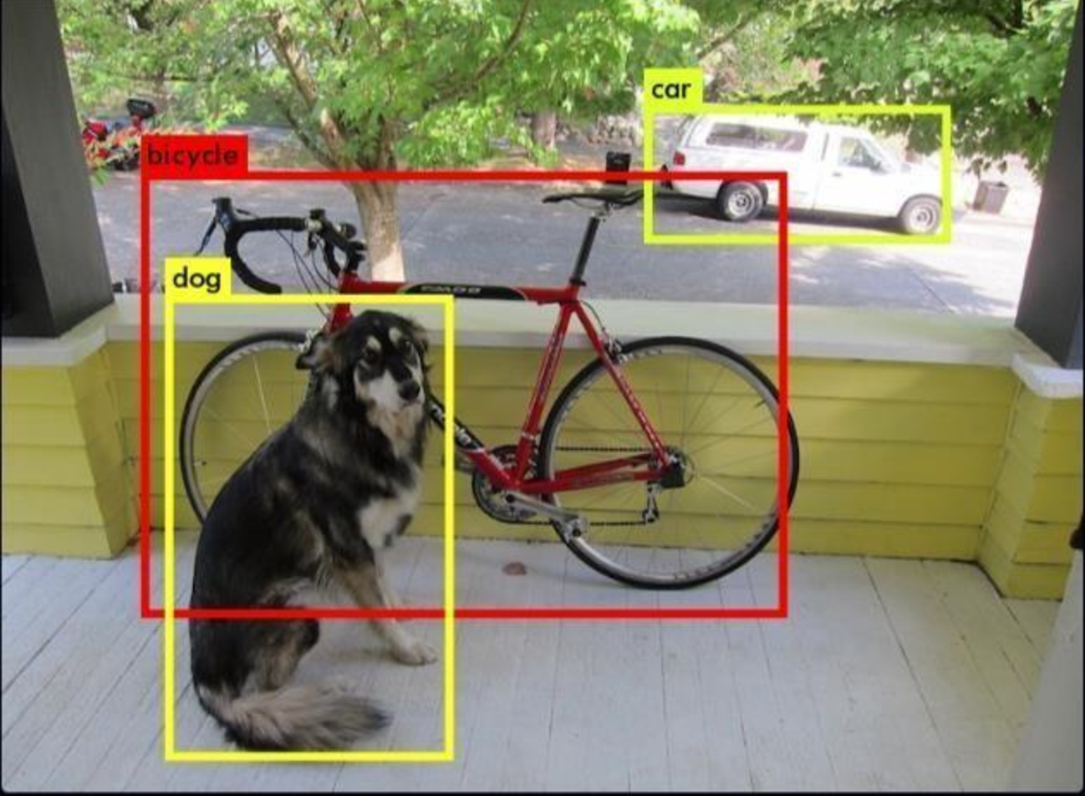
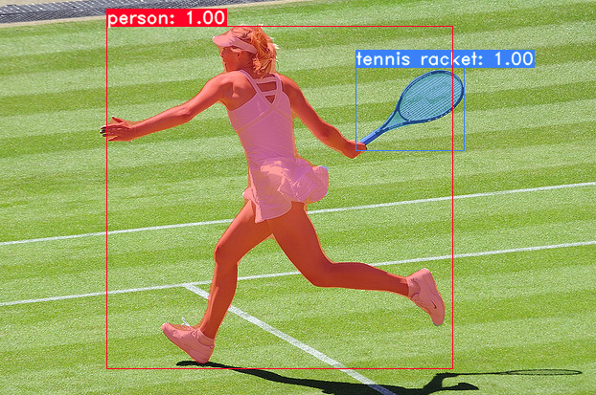
In short..
This is Not
Faster-RCNN
This is Not
Mask-RCNN

Slide 4
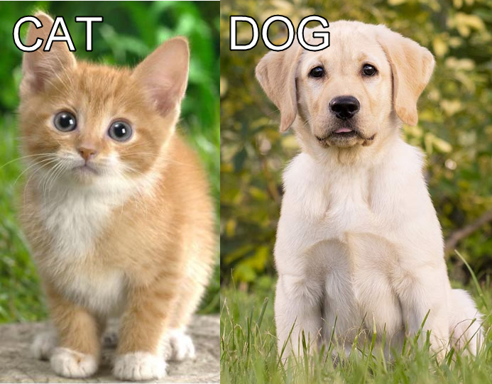
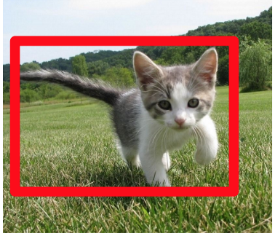
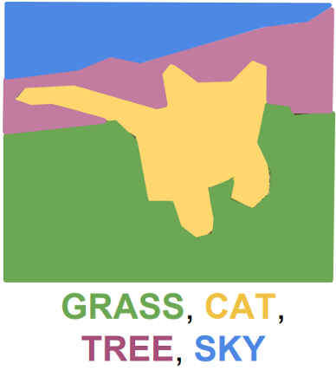
Problems in Computer Vision Image Recognition
Image Classification
Classification + Localization
Semantic segmentation

